Slide 1
Chapter 7
Sorting
We will sort arrays of elements under the assumption that:
The array contains only integers (This can be easily extended to any comparable)
The entire sort is done in memory
We will examine several algorithms based on their performance:
Several easy algorithms that sort in O(N²) such as the insertion sort.
The Shell sort which simple and perform in o(N²)
More complicated sorts that perform in O(nlogn)
We will show that any sort will require Ω(nlogn) comparisons
Apr 12, 2011 | CECS 302. Instructor: I Imam

Slide 2
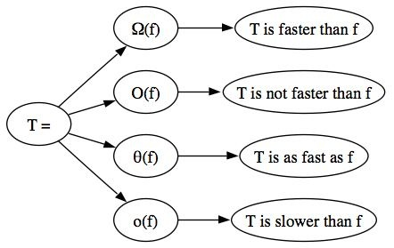
Recall Functions Order
Ω: T(n) = Ω(g(n))
T(n) grows at a rate faster than or equal to g(n)
Big O: T(n) = O(f(n))
T(n) grows at a rate not faster than f(n)
Θ: T(n) = Θ(h(n))
T(n) grows at the same rate ad h(n)
Little o: T(n) = o(p(n))
T(n) grows at a rate smaller than p(n)
Apr 12, 2011 | CECS 302. Instructor: I Imam

Slide 3
Preliminaries
The Textbook assumptions
We have an array (or vector) of n sortable elements
There exits a comparator such as < or >
<, > , and = are the only operations allowed on the elements of the array (at least during the sort function). This is called comparison-based sort
STL functions: STL has sort functions based on the quick sort algorithm. They have different signatures as follows:
void sort(Iterator begin, Iterator end);
void sort(Iterator begin, Iterator end, comparator cmp);
STL style functions require more coding
Apr 12, 2011 | CECS 302. Instructor: I Imam

Slide 4
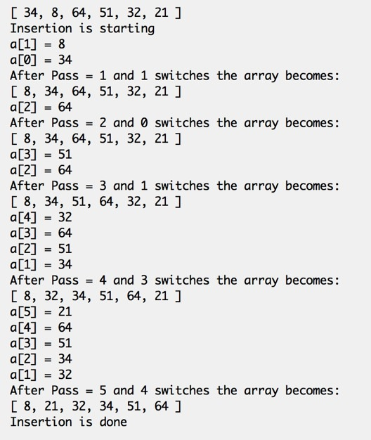
Insertion Sort
The insertion sort starts at position 1 and continues to position n-1. (It has n-1 passes). The pass index is p.
For each p, we compare a[p] with all elements to it’s left (use j as index)
as long as j > 0
If we find a bigger element a[j-1] we replace a[j] with the bigger element a[j-1] and we start comparing from where the big element was and to the left.
Pass 1:
Start at 8.
Compare 8 with 34.
34 is bigger we switch 8 and 34.
there is nothing to the left,
Pass 1 ends.
Pass 2:
64 is bigger than 34
Pass 2 ends
Pass 3:
compare 51 with 64, 64 is bigger.
Switch 64 where 51 was.
compare 51 with left neighbor 34
they are in the right order
Pass 3 ends
Pass 4:
Compare 32 with 64,
switch 64 to where 32 was
compare 32 with 51, then with 34
three switches needed
Pass 4 ends
Apr 12, 2011 | CECS 302. Instructor: I Imam

Slide 5
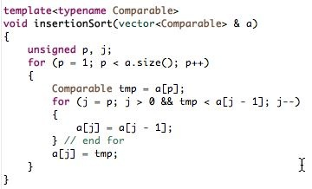
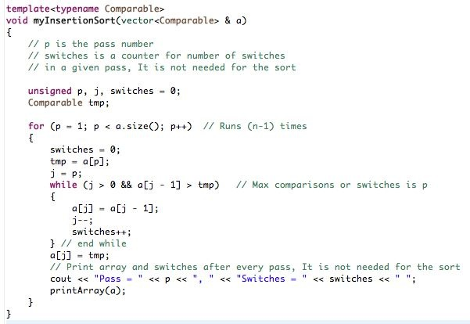
Insertion Sort
Apr 12, 2011 | CECS 302. Instructor: I Imam

Slide 6
Analysis of insertion sort
The outer loop runs for p=1, ..., (size-1). Thus for array a[0] to a[n-1] it runs n-1 times
the inside loop runs from j = p to j = 1. Also, worst case scenario for p is n
Insertion sort is O(n²)
Actual count of tests is p comparisons and one test for j > 0
Total Tests = 2+3+4+...+n = (n(n+1)/2) - 1 = (n² + 2n - 1)/2
Total Tests = θ(n²)
If array already sorted we must perform n tests that all will fail immediately. Thus minimum number of tests is O(n)
The average case: Total Tests = θ(n²)
Apr 12, 2011 | CECS 302. Instructor: I Imam

Slide 7
Lower Bound
An inversion in an array is an ordered pair (i, j) such that
i < j, and
a[i] > a[j]
Inversions in the previous example are:
(34,8), (34,32), (34,21),
(64,51), (64,32), (64,21),
(51,32), (51,21),
(32,21)
Total number of inversions is 9
Total number of switches is 9
Number of inversions is always equal number of needed switches
Every time you make a switch you remove an inversion
The sorted array has no inversions
Apr 12, 2011 | CECS 302. Instructor: I Imam

Slide 8
More on Inversions
Theorem 7.1: The average number of inversion in an array of n distinct elements is n(n-1)/4
Theorem 7.2: Any algorithm that sorts by exchanging adjacent elements requires Ω(n²) time on average.
Apr 12, 2011 | CECS 302. Instructor: I Imam

Slide 9
Shell sort
Invented by Donald Shell in 1959
Shell sort begins by comparing elements that are distance d apart.
Each time we reach the end of the array we have completed a pass.
When an element is moved to a new position it is compared to all its predecessors that are d apart and another sort such as insertion sort is used to rearrange this sub-array.
In each pass, the value of d is reduced to half.
Elements that are quite away from their place will move quickly to their relative position.
Shell sort is the most efficient of the O(n²) class of sorting algorithms. It is also the most complex of the O(n²) algorithms.
Apr 12, 2011 | CECS 302. Instructor: I Imam

Slide 10
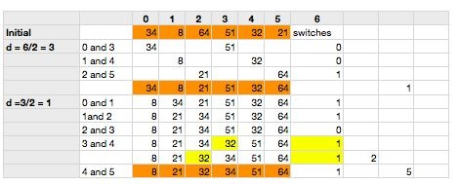
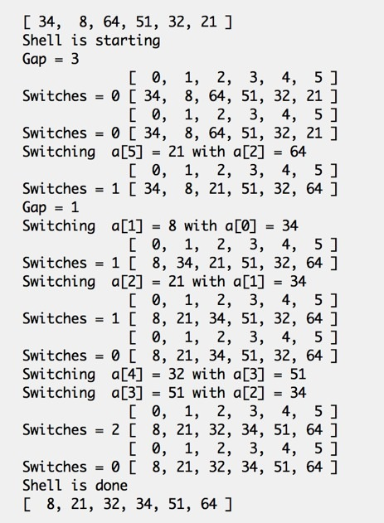
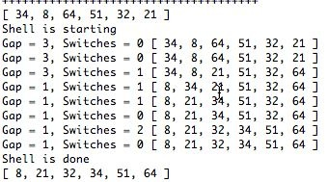
Simple Shell sort Example
Apr 12, 2011 | CECS 302. Instructor: I Imam

Slide 11
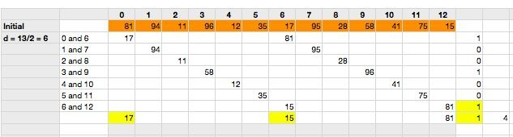
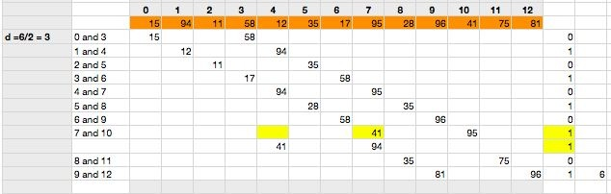
Big Shell sort Example
Apr 12, 2011 | CECS 302. Instructor: I Imam

Slide 12
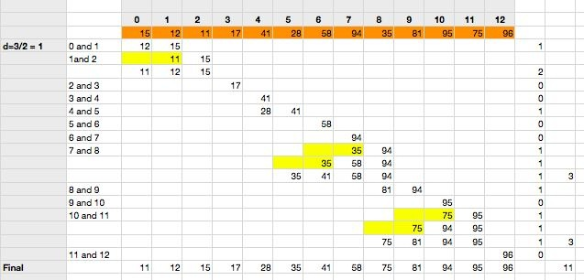
Big Shell sort Example (cont.)
Apr 12, 2011 | CECS 302. Instructor: I Imam

Slide 13
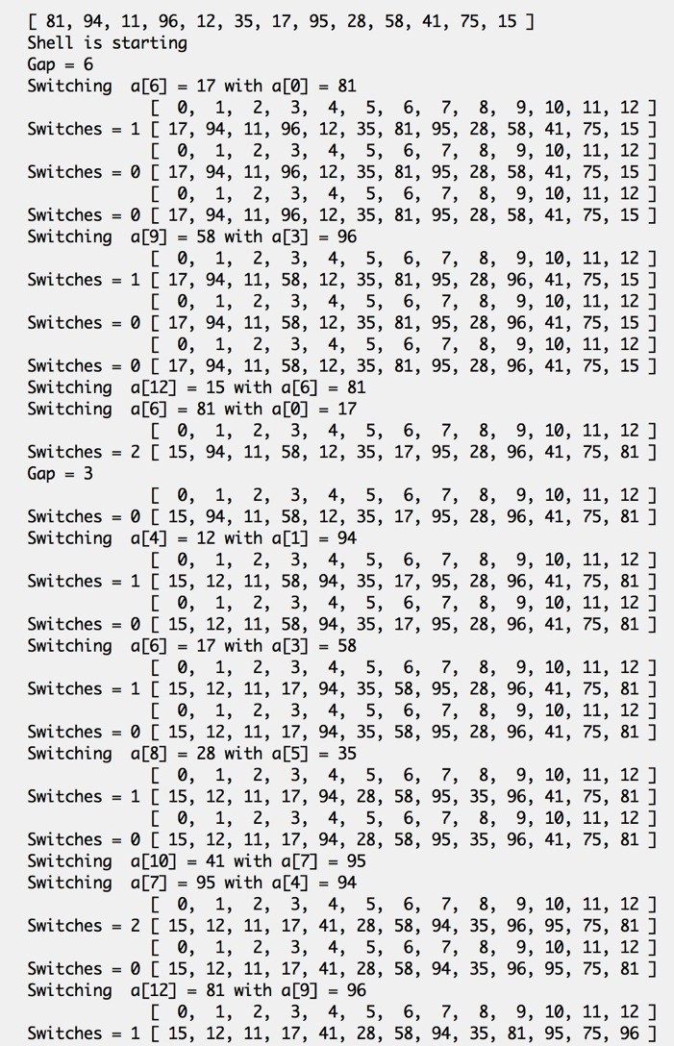
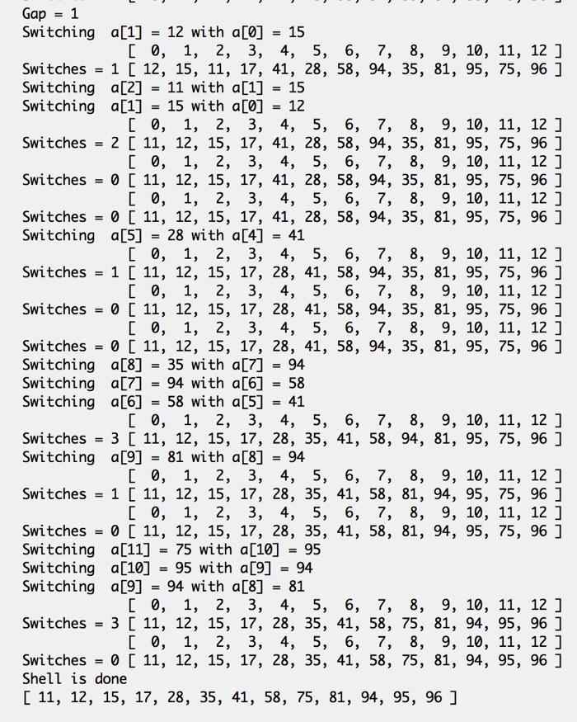
Big Shell sort Example (cont.)
Apr 12, 2011 | CECS 302. Instructor: I Imam

Slide 14
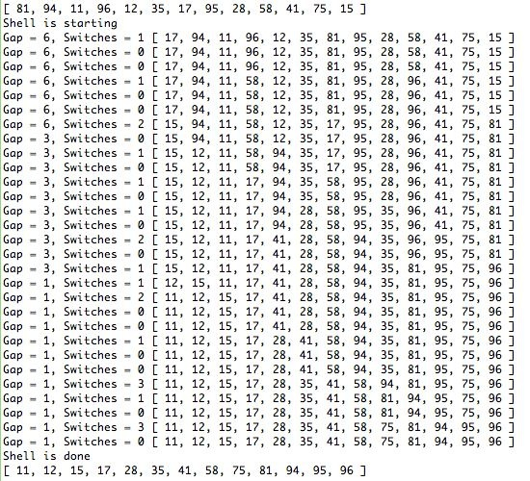
Big Example Output
Apr 12, 2011 | CECS 302. Instructor: I Imam

Slide 15
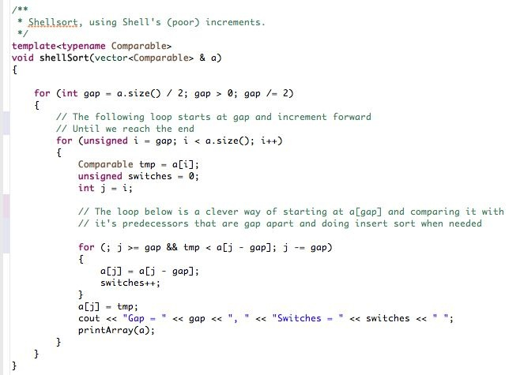
The Shell Sort Routine
For n = 13 we have gap = 6,3,1
When gap is 6 we move through 6,7,8,9,10,11, and 12
Here we compare a[6] with a[0], a[7] with a[1] looking backward and doing the switches if necessary
Apr 12, 2011 | CECS 302. Instructor: I Imam

Slide 16
Notes about Shell sort
Shell sort is sometimes referred to as diminishing increment sort
The gap size is the diminishing increment.
Many research is done establishing sequences of gaps (increments) h1, h2, h3, ... ht with h1 always 1
After finishing the pass with increment hk we must have all elements that hk apart sorted.
The array is then said to be hk-sorted and we have a[i] <= a[i+hk] whenever the indices are valid
Popular but poor sequence is ht = ⎣n/2⎦and hk = ⎣ hk+1/2⎦
Apr 12, 2011 | CECS 302. Instructor: I Imam

